Slide 1

Automating IBD Classification using NLP and ML Models
Venkata Naga Sai Neeharika
Ayush Tarun Jain
Wangyue Zhang
Evgeny Vorobyev
Yash Yadav

Slide 2

TABLE OF CONTENTS
Introduction
Relevance to IH's Strategy and Operations
Problem Statement
Advantages of Automation
Project flow
Data Description
Data Wrangling
Transformation
ML Models and Clustering
Algorithm’s Performance
Conclusion
Key Takeaways

Slide 3

INTRODUCTION
Goal: To explore whether the process of classifying IBD as active or inactive could be automated using text as the main input.
Data: Collected data from Provation and Gastrointestinal (GI’s) responses.

Slide 4
Relevance to IH's Strategy and Operations
Optimizing patient care through timely identification of active IBD.
Enhancing data-informed decision-making.
Addressing challenges associated with unstructured data usage.
Informing data utilization and integration with EHR data.
IBD Analysis

Slide 5

Problem Statement
Problem: The manual process of classifying IBD as active or inactive, which is time-consuming and requires expertise.
Solution: To automate the process using text as the main input. This would involve building an ML model or customized pipeline that can accurately classify IBD as active or inactive based on the text data from Provation.

Slide 6
Advantages of Automation
Workload Efficiency
Accuracy and Consistency
IBD Analysis
Reduces the manual workload of healthcare professionals, freeing up time for more critical tasks
Improve the accuracy and consistency of IBD activity classification.

Slide 7
Project Flow
Data Collection
Exam Notes Parsing
Transform
Pre-Processing
Modelling
Optimizations

Slide 8
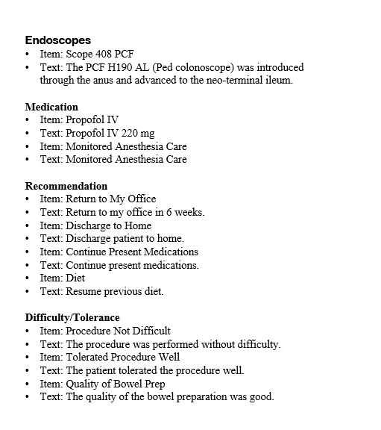
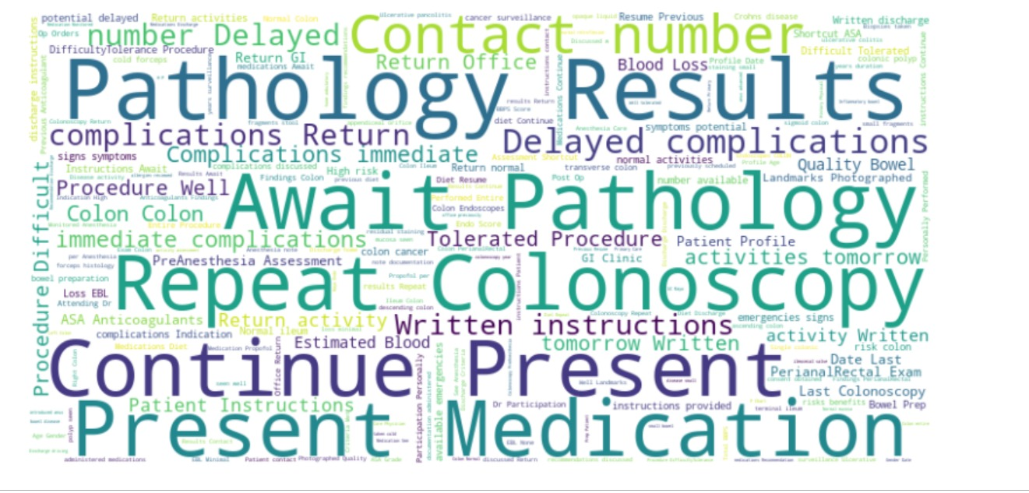
Data Description
Exam Notes : Text from exam notes and Image locations - 5161 records
Gastrointestinal (GI) results of patients with IBD .
Crohn's disease – 372 records
Ulcerative colitis – 361 records
The data was preprocessed to remove stop words and punctuation, and then parsed to identify unique words from active vs inactive disease.

Slide 9
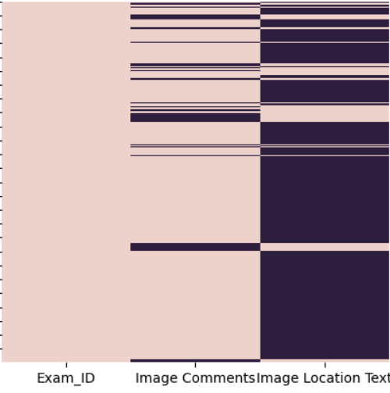
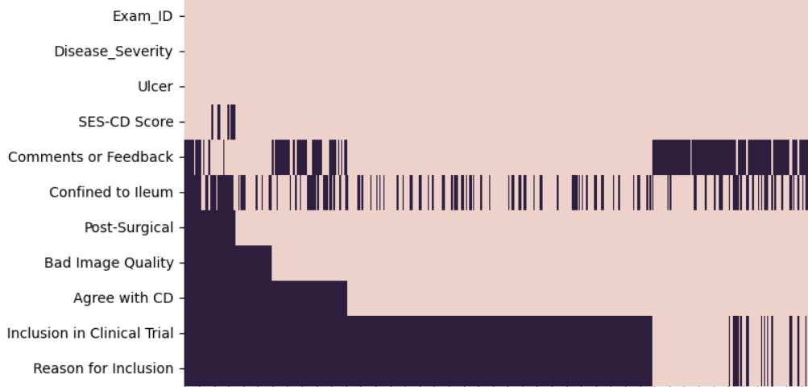
Data Description
Average null plot of Image Datasets:
Out of 25,000 rows, only we only have 2,000 patients(approximated)
Average null plot of GI Response Datasets:
Other than 3 Columns(Exam_ID, Disease_Severity and Ulcer) nothing matches between Crohn’s data and Ulcerative Colitis data.

Slide 10
Data Wrangling
GI Response, UC
402 rows X 12 columns
Image Ulcerative Colitis
25927 rows × 3 columns
Image Crohn’s Disease
21724 rows × 3 columns
GI Response, CD
425 rows X 11 columns
Final Dataset
730 × 5
Exam Notes(from Exam Notes), Ulcers(from both GI responses), Image Info.(from Image datasets), Disease Severity(from GI Responses datasets), Patient ID(from every dataset)
Exam Notes
5161 rows X 2 columns

Slide 11
Transformation
Punctuations
Stop words
Vectorization
Vocabulary
, . : ; / ? ‘ “ ( ) ! @ # $ % ^ & *
The, a, an, that, this, …
Built vocabulary of distinct words in all exam notes
BagOfWords, TF-IDF, Word2Vec, n-grams

Slide 12
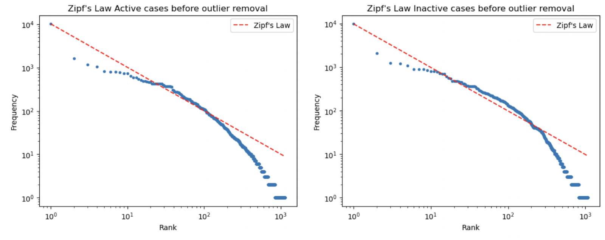
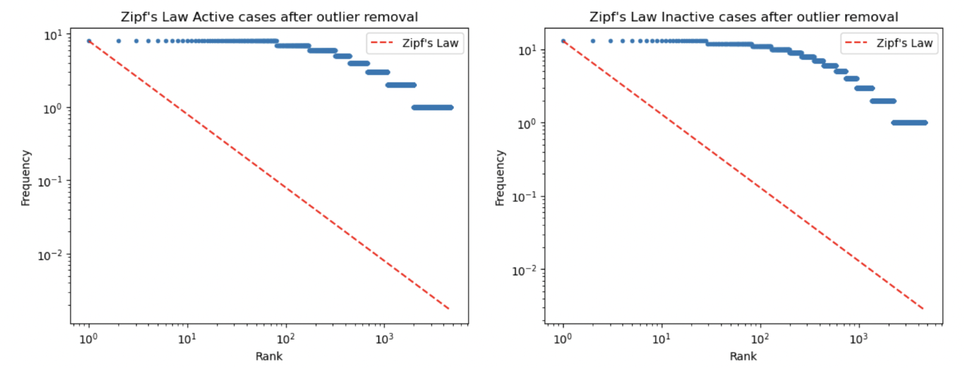
Zipf's law
Frequency of words (blue dots) in original dataset somewhat correlates with Zipf's law (dashed red), meaning that the most common word will occur twice as often as the second most common word, three times as often as the third most common word, and so on.
By removing outliers, we are effectively cutting off the highest and lowest frequencies in the data. Removing the outliers from the dataset even more weakened the correlation with Zipf's law.

Slide 13
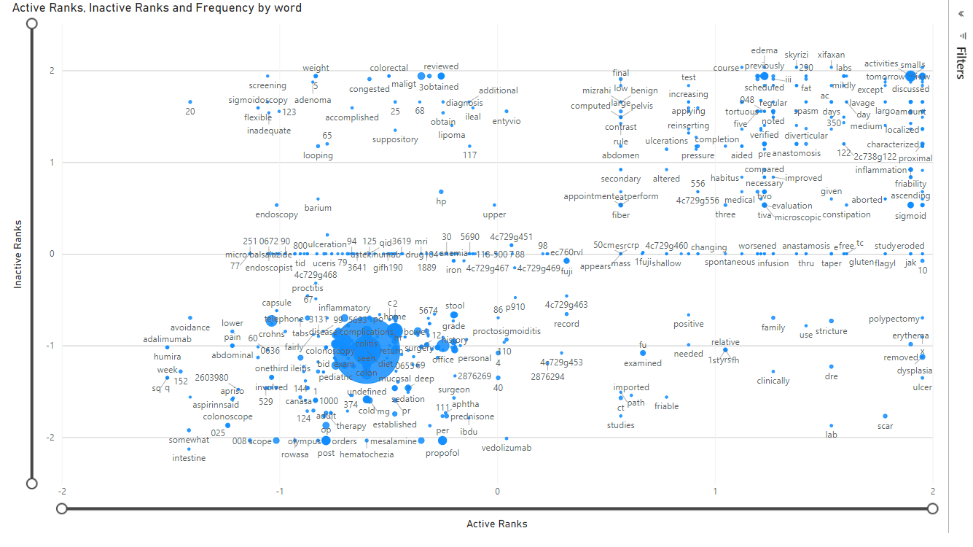

Slide 14

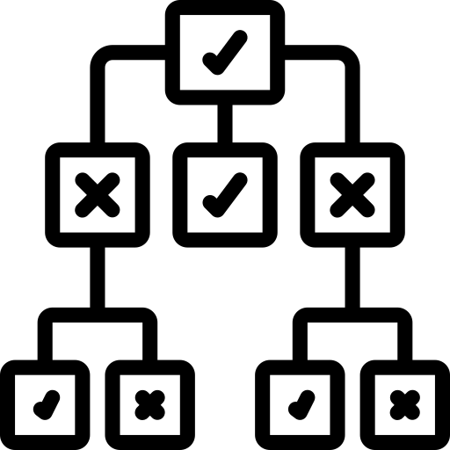
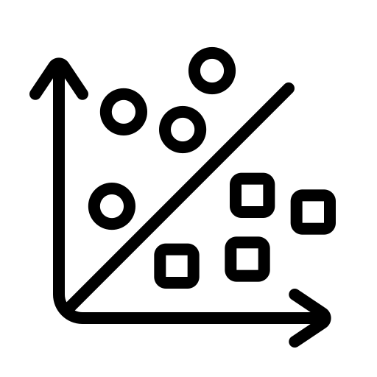


ML Models and Clustering
Gradient Boosting
Decision Tree
Support Vector Machine
Multi Layer Perceptron
Kmeans Clustering

Slide 15

Metrices of Performance: F1 Score, Precision, Recall
Precision measures the proportion of correctly predicted positive instances out of all instances predicted as positive.
Recall, also known as sensitivity or true positive rate, measures the proportion of correctly predicted positive instances out of all actual positive instances.
F1 Score provides a comprehensive evaluation of the model's performance by considering both measures.
F1 Score = 2 * (Precision * Recall) / (Precision + Recall)

Slide 16
Algorithm’s Performance
Model | F1 Score | Precision | Recall
Decision Tree | 0.608 | 0.522 | 0.727
SVM | 0.516 | 0.532 | 0.500
Gradient Boost | 0.697 | 0.607 | 0.818
MLP | 0.585 | 0.594 | 0.576
KMeans | 0.816 | 0.850 | 0.785
From Supervised Learning
From Unsupervised Learning
Metrices | Gradient Boosting Model
Precision | 60.7% correctly predicted active cases out of all cases predicted as active
Recall | 81.8% correctly predicted active cases out of all cases
Metrices | Gradient Boosting Model
Precision | 85% correctly predicted active cases out of all cases predicted as active
Recall | 78.5% correctly predicted active cases out of all cases

Slide 17
Conclusion
This project demonstrated the feasibility of automating the process of classifying IBD as active or inactive using NLP techniques and ML models.
The use of text as the main input allowed for the development of accurate and generalizable models that can reduce the workload of healthcare professionals and improve the consistency and accuracy of the classification.
Future research could explore the integration of EHR data with Provation data to further improve the accuracy and usefulness of the classification.
Overall, this work has significant implications for the management of IBD and the use of electronic medical records in healthcare.

Slide 18
Key Takeaways
Efficient and Objective Decision Making
Actionable Insights
All the datasets are not consistent, huge number of duplicates make the process of structuring the unstructured data difficult.
Cost Savings
Automating IBD classification can result in cost savings. By reducing the need for manual analysis.
Automating the classification of IBD activity can provide a more efficient and objective approach to determining whether a patient's condition is active or inactive.
Improvements
Improvements in Data Integration or Data Collection can help in formulating one final data which will play a key role in predicting active and Inactive which further tells the importance of Exam Notes it’s relationship with Disease Severity

Slide 19

Any questions !!

Slide 20



